Slide 1
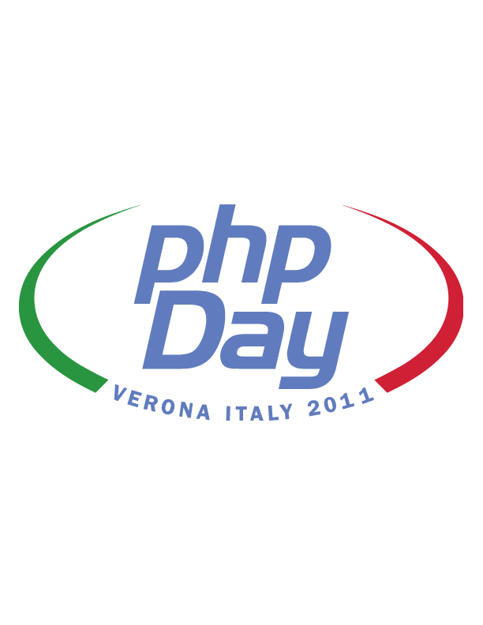
Doctrine 2
Juozas “Joe” Kaziukėnas
http://juokaz.com / juozas@juokaz.com / @juokaz

Slide 2

Who am I?
Juozas Kaziukėnas, Lithuanian
You can call me Joe
3 years in Edinburgh, UK
CEO of Web Species Ltd
Software developer, consultant and evangelist
Conferences speaker
Open source developer for Zend Framework, Doctrine…
More info in http://juokaz.com and twitter @juokaz

Slide 3



Who are you?
Doctrine users?
Propel users? (you will be converted!)
Symfony2 users?
Interested in DB’s and PHP?
Interested in PHP news?

Slide 4
Doctrine is ORM tool for PHP
Inspired by Hibernate, ActiveRecord etc.

Slide 5
Doctrine 1.X

Slide 6

Doctrine 1.X
Slow
High memory usage (cyclic references)
Magic! (eg. Behaviors)
Hard to execute raw SQL
Still the best ORM for PHP available today

Slide 7
Active Record
Root of all problems!

Slide 8
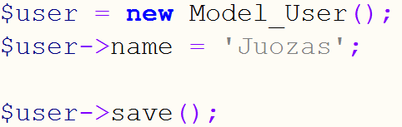
Active Record

Slide 9

Used to be the best ORM available
Stable
Works
Makes development fast, clean and consistent
Used in production
Symfony 1.X

Slide 10
Doctrine 2

Slide 11
Doctrine 2 is completely different

Slide 12
Doctrine 2 is completely different*
* Everything you can do in Doctrine 1 you can do in Doctrine 2, just in a different way.

Slide 13

What’s new?
Rewritten from scratch (almost)
PHP 5.3
Decoupled components
Simplified API
“Complexified” internals?..
Performance
New hydration
Less magic
Overall cleanup

Slide 14
Doctrine 2 Architecture
Based on JSR-317 a.k.a. JPA v2.0

Slide 15
[Common, DBAL, ORM, ODM]

Slide 16

Common
Caching
Events
Annotations
Class loaders
… more

Slide 17
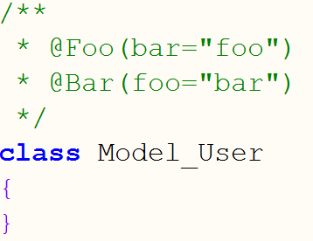
Annotations

Slide 18
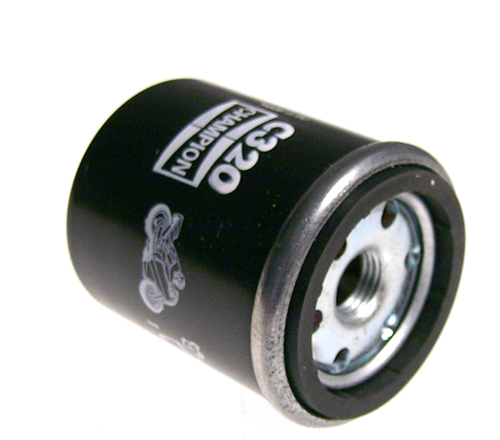
DBAL
Can be used without ORM
Abstraction for MySQL, PgSQL, Oracle, Microsoft SQL, DB2 etc.
PHP types mapping to DB types
Extendable
… more

Slide 19
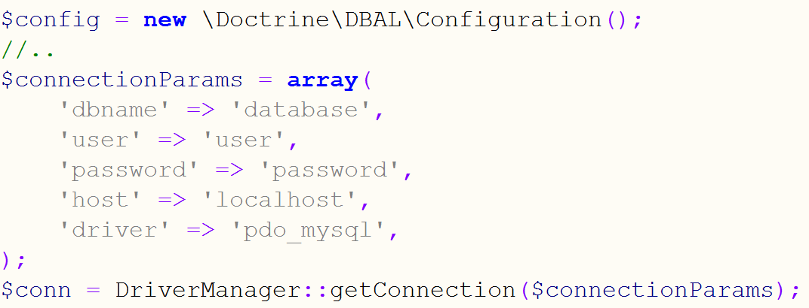
Connection

Slide 20
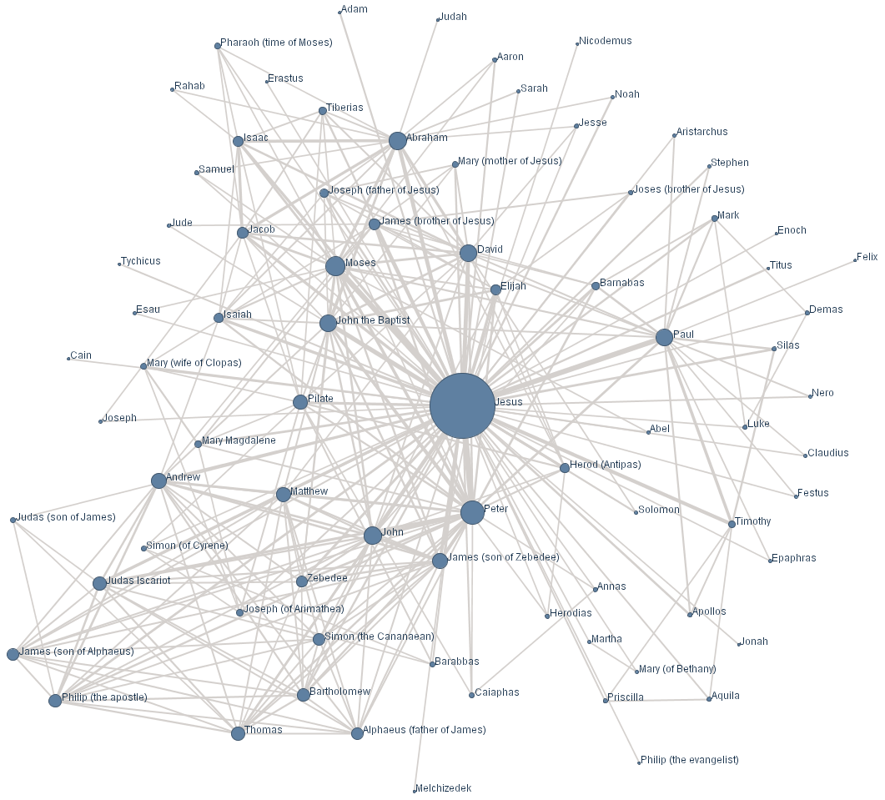
ORM
Actual ORM component
Uses Common and DBAL
No more ActiveRecord
Entities
Metadata mapping
Entity manager
Query language
Faster, cleaner, clever, extendable
No forcing

Slide 21
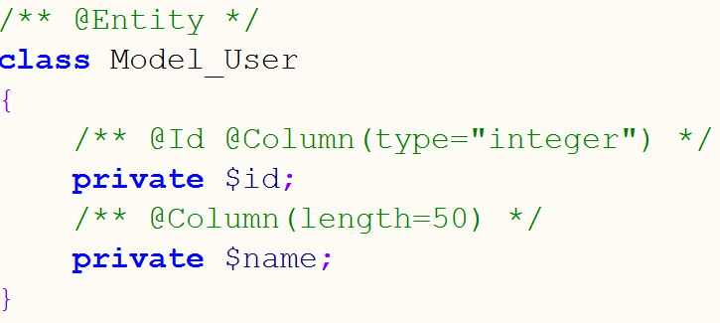
Entity

Slide 22
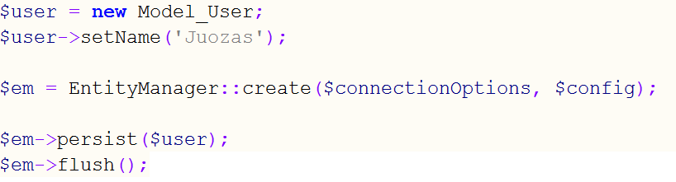
EntityManager

Slide 23
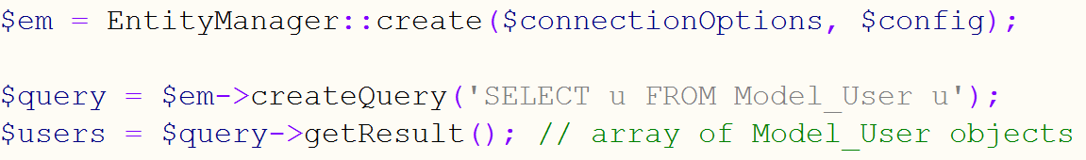
Querying

Slide 24
ODM? Hell yeah NoSQL!!!
MongoDB, CauchDB

Slide 25

ODM
Abstracts NoSQL databases
Similar Metadata configuration
A lot of functionality from ORM also available in ODM
Querying
EntityManager -> DocumentManager
Driven by OpenSky team, mainly

Slide 26
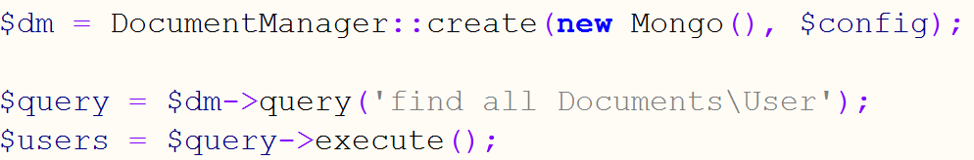
ODM Querying

Slide 27
Much more!

Slide 28

Migration
Migrating from Doctrine 1 to Doctrine 2
Can be tricky
Migrating:
… models is easy
… application code can require some major refactoring
Do it only if it’s worth it

Slide 29

Finishing
Doctrine 2 is out
“The library” for PHP 5.3
Symfony2, Zend Framework 2 etc.
Works well, development is continuing

Slide 30
Questions?

Slide 31
Thanks!!!
Juozas Kaziukėnas
http://juokaz.com
juozas@juokaz.com
twitter: @juokaz
Rate this talk at http://joind.in/2990
* Illustrations from http://images.google.com

